Slide 1


Year 5 – Week 17 Maths & NVR

Slide 2
Lesson Outline
Example Questions
Maths Starter
Volume & Surface Area
NVR – Codes

Slide 3

Non-Verbal Reasoning

Slide 4
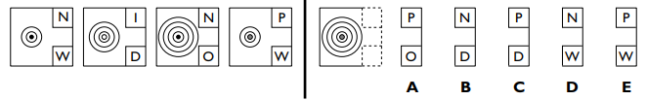
NVR – Codes
Each figure on the left has a code next to it. Decide how the code letters match the shapes. Look at the shape on the right and work out its code.
Practice 1
The upper letter signifies the colour of the central circle; the lower letter signifies the number of circles.
Answer: A

Slide 5
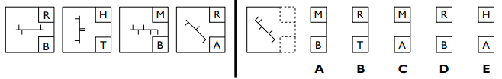
NVR – Codes
Each figure on the left has a code next to it. Decide how the code letters match the shapes. Look at the shape on the right and work out its code.
Practice 2
The upper letter signifies the number of short lines; the lower letter signifies the orientation of the long line.
Answer: C

Slide 6
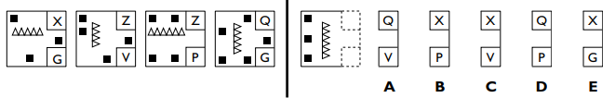
NVR – Codes
Each figure on the left has a code next to it. Decide how the code letters match the shapes. Look at the shape on the right and work out its code.
Practice 3
The upper letter signifies the number of squares; the lower letter signifies the number of triangles.
Answer: B

Slide 7
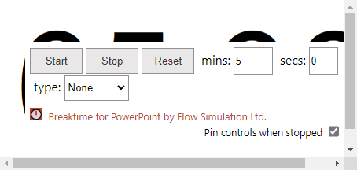
You have five minutes to complete NVR Test

Slide 8

Volume of 3D Shapes

Slide 9
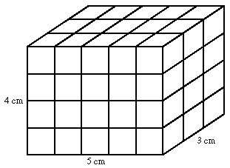
What is Volume?
Volume is the amount of space a 3D shape takes up.
A cubic cm block takes up 1 cubic cm. This is written as 1 cm³.
You can work out the volume of a shape by multiplying height × width × depth.

Slide 10
Volume of a cuboid
We can find the volume of a cuboid by multiplying the area of the base by the height.
The area of the base
= length × width
So,
height, h
Volume of a cuboid
= length × width × height
= lwh
length, l
width, w

Slide 11
Volume of a cuboid
What is the volume of this cuboid?
Volume of cuboid
= length × width × height
5 cm
= 13 × 8 × 5
8 cm
13 cm
= 520 cm³

Slide 12
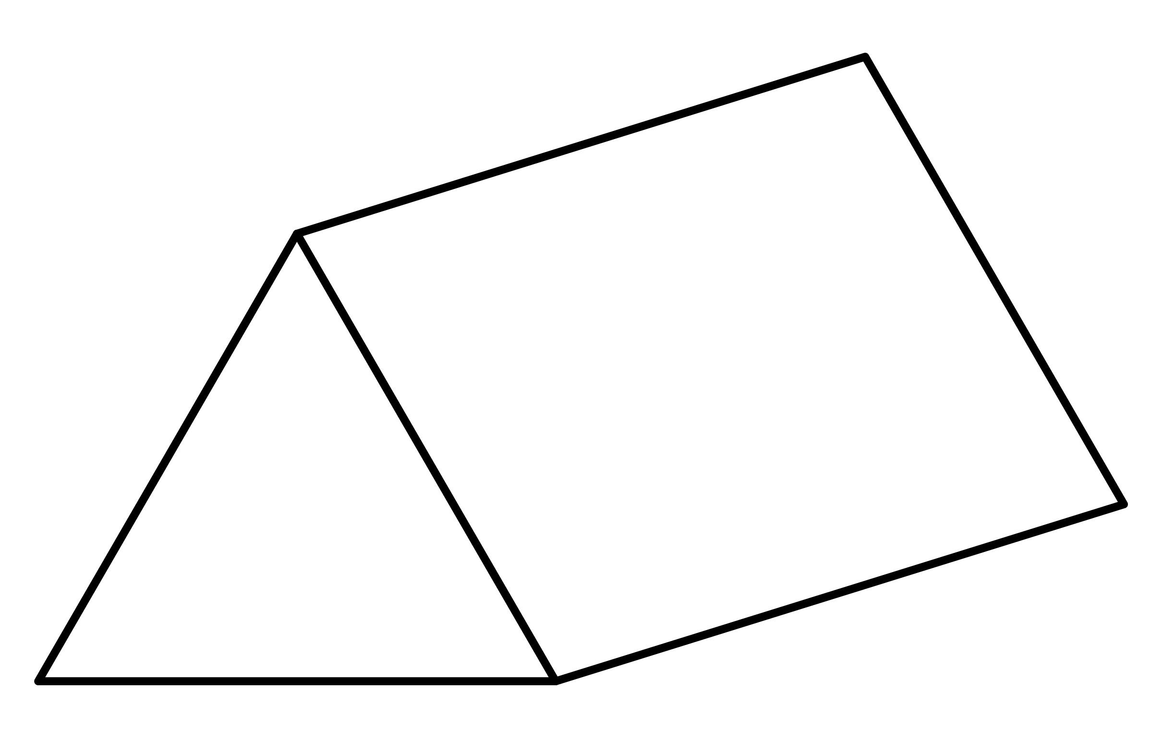
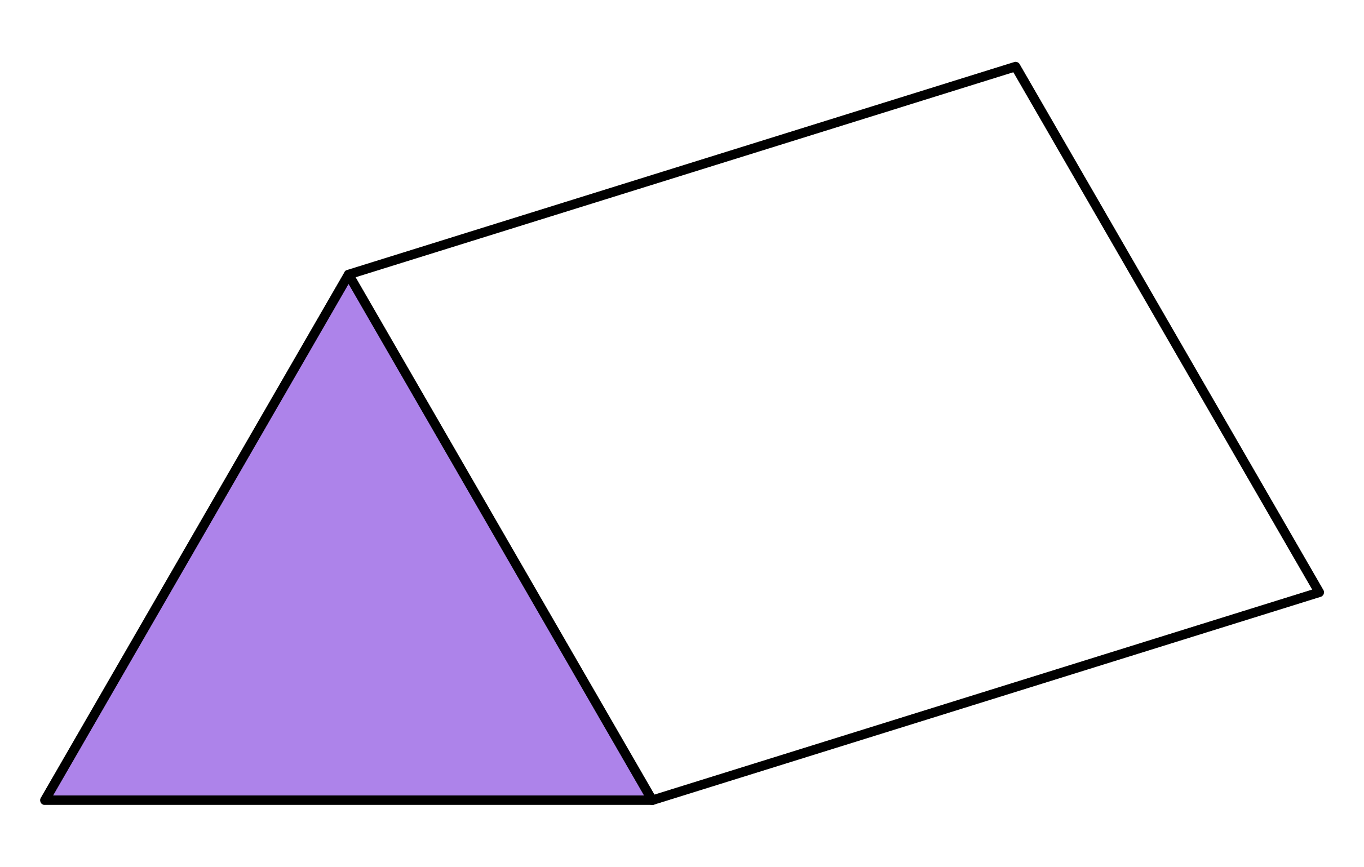
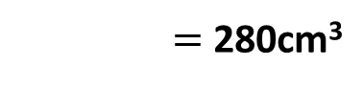
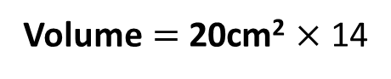
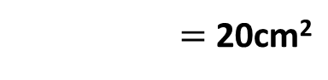
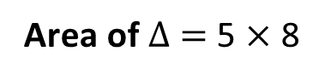
Volume of a Prism
Volume of a prism $=$ Area of cross-section $×$ length
Find the volume of the triangular prism.
Solution
8cm
14cm
5cm
Area of $Δ$ $=$ 5 $×$ 8
Volume $=$ 20cm² $×$ 14
2
Volume $=$ 280cm³
Area of $Δ$ $=$ 20cm²

Slide 13
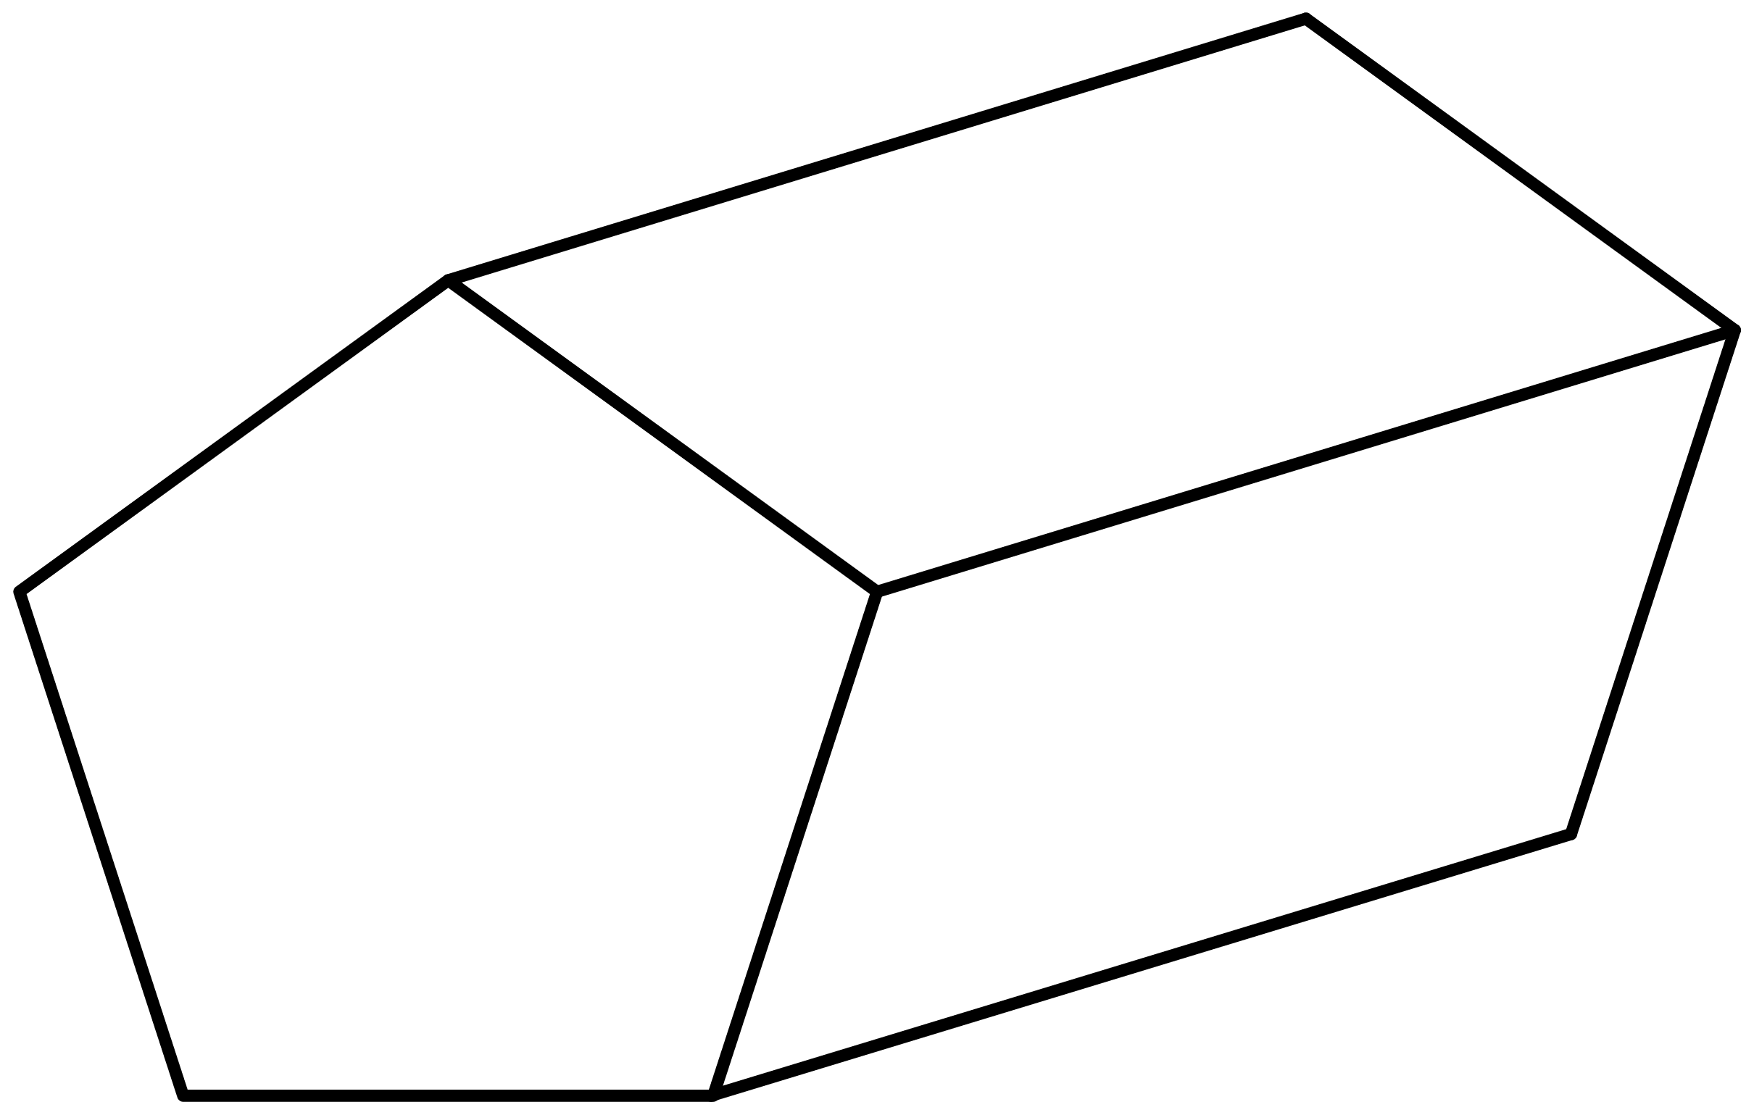
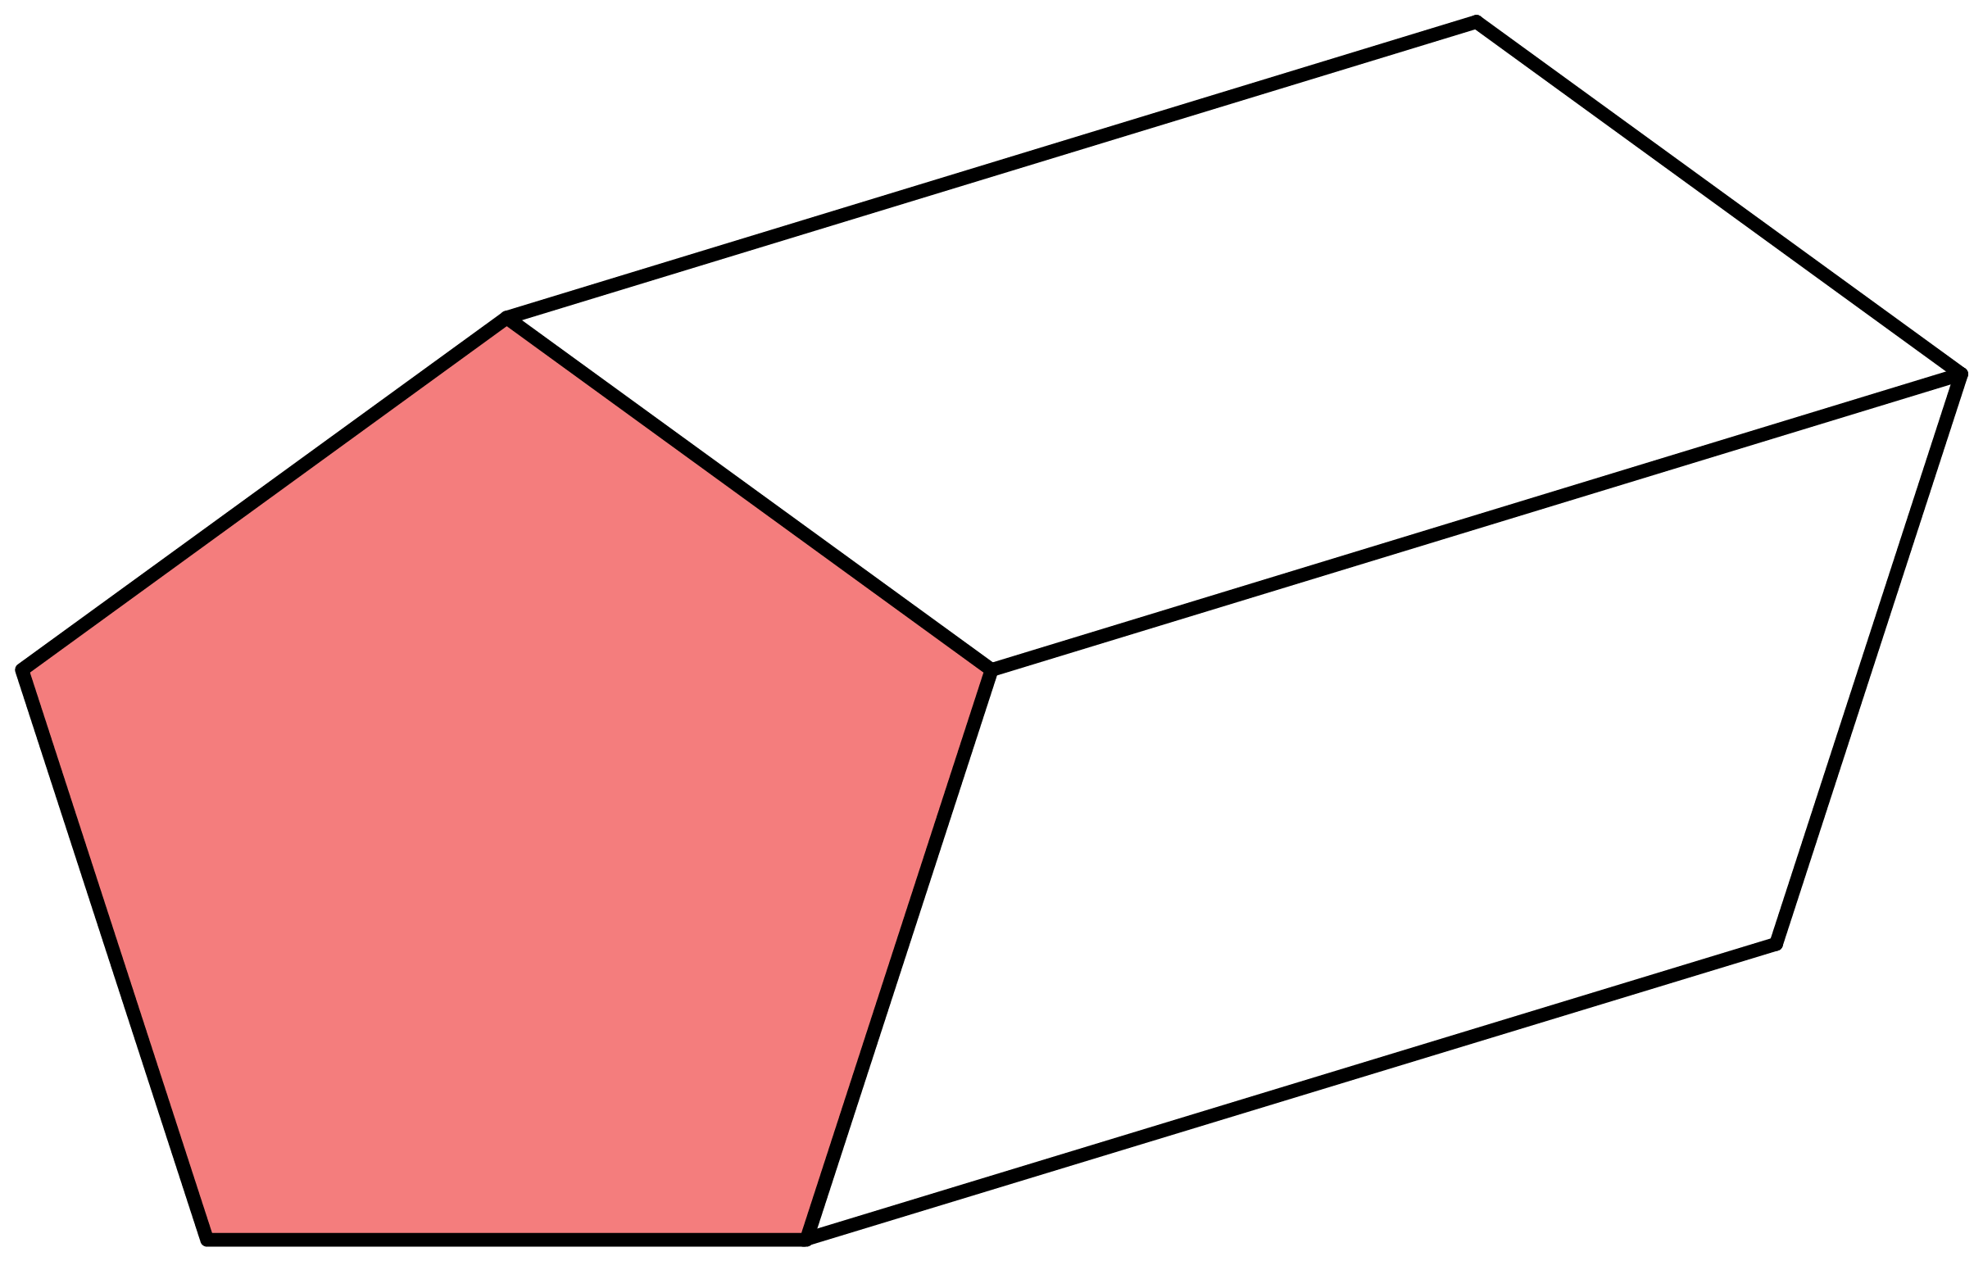
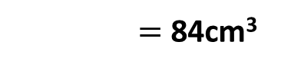
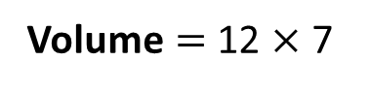
Volume of a Prism
Volume of a prism $=$ Area of cross-section $×$ length
Find the volume of the pentagonal prism.
Solution
Area
12cm²
7cm
Volume $=$ 12 $×$ 7
Volume $=$ 84cm³

Slide 14
Area of a circle
Area
= π × radius × radius
= π × radius²
radius
area

Slide 15
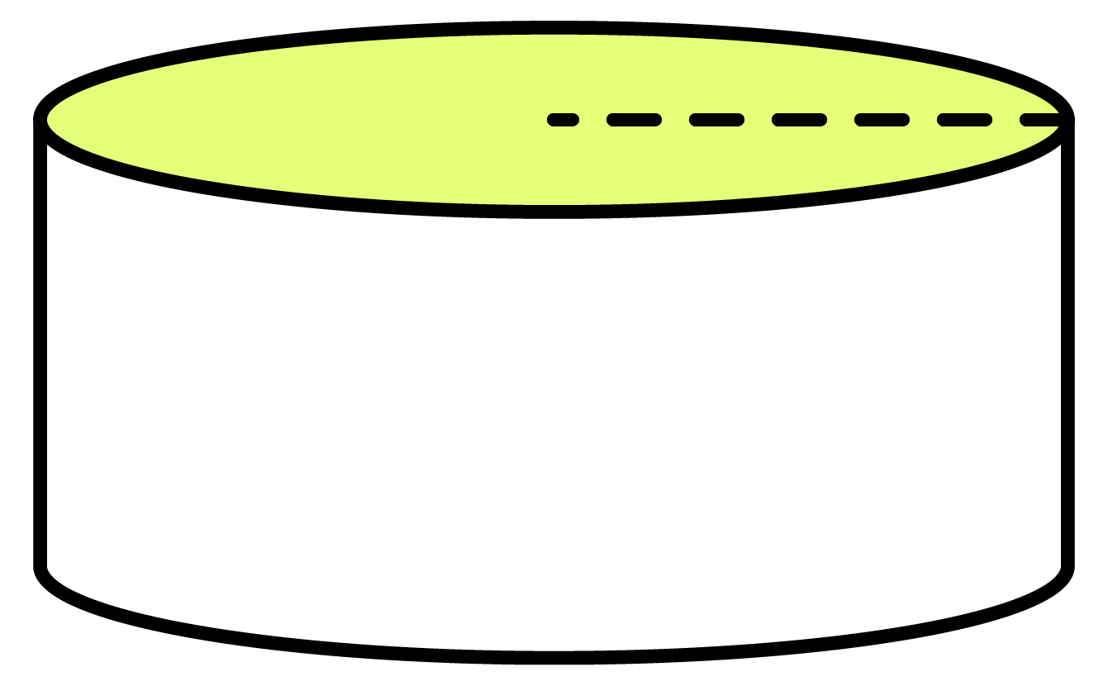
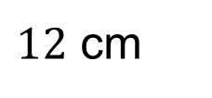
Volume of a cylinder
Volume of a cylinder
Volume of circular base 30 cm²
= Volume of circular base × height
So, 12cm x 30 cm² = 360cm³
$12$ cm

Slide 16
Surface Area

Slide 17
Surface Area of a cube
How can we find the surface area of a cube of length 4cm?
All six faces of a cube have the same area.
The area of each face is 4 × 4 = 16
Therefore,
4
Surface area of a cube = 16 x 6 = 96cm²
Notes:
Ask pupils to use this formula to find the surface area of a cube of side length 5 cm.
6 × 5² = 6 × 25 = 150 cm².
Repeat for other numbers.
As a more challenging question tell pupils that a cube has a surface area of 96 cm². Ask them how we could work out its side length using inverse operations.

Slide 18
Surface Area of a cuboid
To find the surface area of a cuboid, we calculate the total area of all of the faces.
A cuboid has 6 faces.
The top and the bottom of the cuboid have the same area.
Notes:
Discuss the meaning of surface area. The important thing to remember is that although surface area is found for three-dimensional shapes, surface area only has two dimensions. It is therefore measured in square units.

Slide 19
Surface Area of a cuboid
The front and the back of the cuboid have the same area.

Slide 20
Surface Area of a cuboid
Surface area of a cuboid =
4
8
2 × (8 × 4)
Top and bottom
6
+ 2 × (6 × 8)
Front and back
+ 2 × (6 × 4)
Left and right side
Surface area of a cuboid = (2×32) + (2×48) + (2×24)
Notes:
Pupils should write this formula down.

Slide 21
Other Shapes
What is its surface area?
Area of each face = ½bh
= ½ × 6 × 5
= 15 cm²
5 cm
Surface area = 4 × 15
= 60 cm²
6 cm
Notes:
Point out that a regular tetrahedron has 4 equilateral triangular faces.

Slide 22

Have a go at the rest of the maths questions

Slide 23

Well done for all your hard work today!

